Slide 1
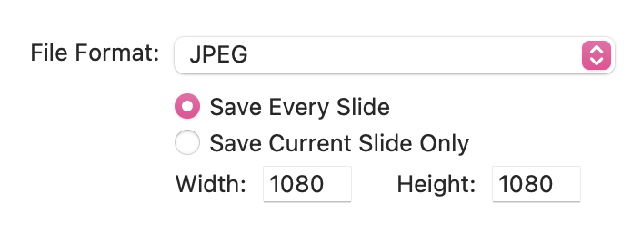
How to Use This Template
On slides 2 and 6, replace the bracketed text with your text.
Go to File > Export.
Choose the folder for your exports.
In the File Format field, select JPEG.
Select “Save Every Slide” and ensure the width and height are at 1080 px.
Click Export.

Slide 2
[insert location and time here].

Slide 6
[insert relevant website/points of contact info].

