Slide 1
IPC for Marburg Virus Disease (MVD): Injection Safety
Healthcare Settings with Limited to Intermediate Resources
Updated: March 2023
Notes:
Intended Audience: This presentation focuses on what healthcare workers should know about injection safety during a Marburg virus disease outbreak.
Please note that the IPC for Marburg Virus Disease topics are presented in sequence, with the expectation that participants will progress through the series. You may, however, mix and match content to meet participant needs, and you may need to adjust the sample script accordingly.
Script:
Welcome! Today we'll be focusing on injection safety during a Marburg virus disease outbreak. We’ll talk about why it’s important to help prevent transmission of Marburg virus disease in healthcare facilities, and then we’ll talk about steps to take to ensure your safety and your patients’ safety when you give injections.

Slide 2
Learning Objectives
After this presentation, participants will be able to
Explain why one needle and one syringe for one patient one time is important in the context of Marburg virus disease
Describe 3 things to avoid when disposing of used needles.
Notes:
Script:
We have 2 learning objectives for today. By the end of our time together, you should be able to explain why one needle and one syringe for one patient one time is important in the context of Marburg virus disease. You should also be able to describe three things to avoid when disposing of used needles.

Slide 3
Discuss
Many steps are required for giving injections safely. What are 2 things you always do when preparing or giving an injection to keep you and/or your patient safe?
Notes:
Activating background knowledge:
A key benefit of working with adult learners is that they likely already have some knowledge or experience related to the topic you are teaching. Activating background knowledge helps students connect new learning to what they already know and may help them understand new information better. It also helps you, the instructor, to identify gaps in knowledge where you may need to spend extra time or add emphasis while teaching. Use this slide as an opportunity to let students share what they already know.
Script:
Many of you may give patients injections on a regular basis. Many steps are required for giving injections safely. What are 2 things you always do when preparing or giving injections to keep yourself and/or your patient safe?
[Allow a few participants to share their answers. Answers may vary.]
We are going to spend most of our time today talking about steps to take to make injections safe in the context of Marburg virus disease, but first, let’s talk about why injection safety is important.

Slide 4
Why Injection Safety?
Unsafe injection practices can lead to transmission of Marburg virus disease to patients and staff.
Re-using needles and syringes might contribute to spread of Marburg virus disease among patients.
Unsafe disposal leading to accidental needle sticks can contribute to spread of Marburg virus disease among patients and staff.
Following safe injection practices helps protect you, your patients and coworkers, and your community from Marburg virus disease.
Notes:
Script:
Using unsafe injection practices may allow blood-born pathogens such as Marburg virus disease to be transmitted to patients and staff. Certain practices such as re-using needles and syringes and unsafe disposal of needles can lead to the spread of Marburg virus disease to patients and staff.
By following safe injection practices as we’ll talk about today, you help to protect yourself and also the patients and coworkers in your facility. By keeping yourself safe from Marburg virus disease, you protect those you come in contact with in your community including your family and friends.

Slide 5
7 Steps for Safe Injections
STEP 1: Hand hygiene
STEP 2: Clean workspace
STEP 3: Sterile and new syringe and needle
STEP 4: Sterile vial of medication and diluent
STEP 5: Skin preparation
STEP 6: Appropriate collection of sharps
STEP 7: Appropriate waste management
https://www.who.int/infection-prevention/tools/injections/IS_HealthCareProviders_Leaflet.pdf
Notes:
Script:
These are the seven steps for safe injections as defined by the World Health Organization. [Read the list.]
We’re going to look at each step in more detail.

Slide 6
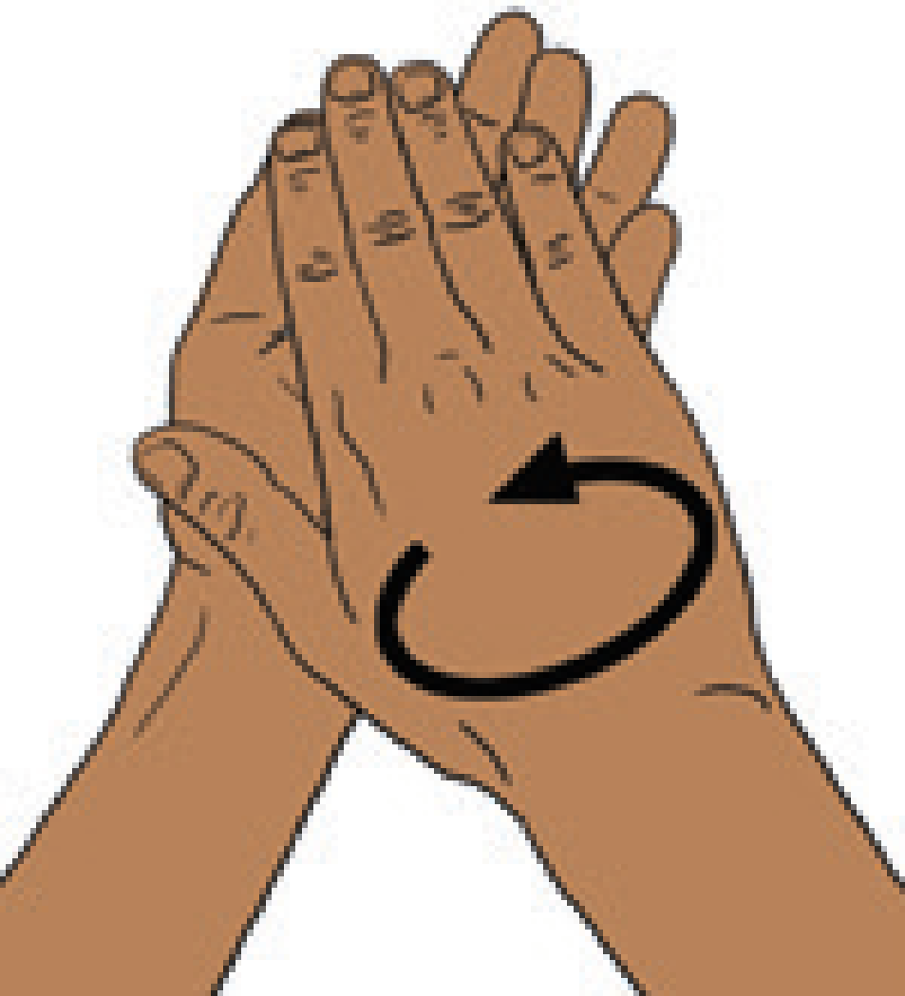
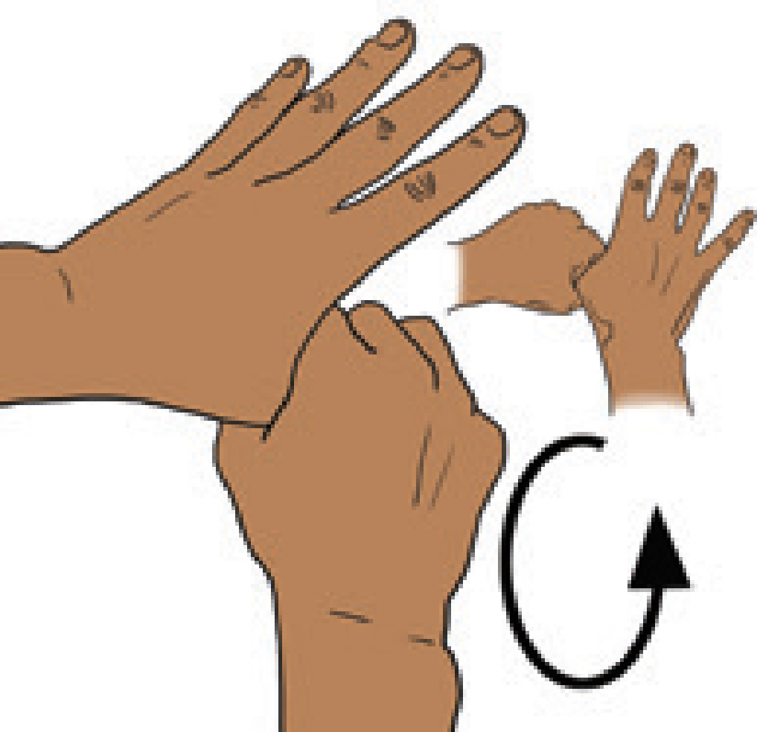
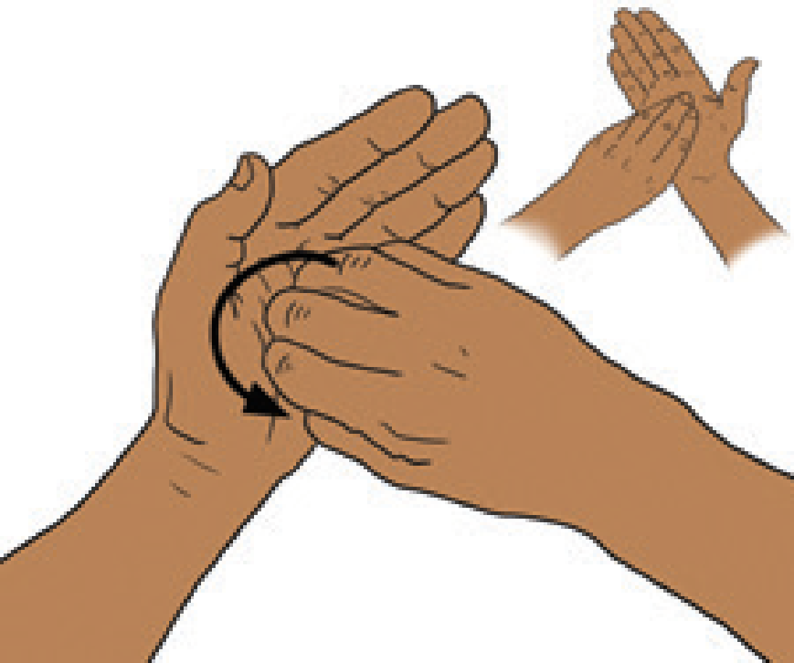
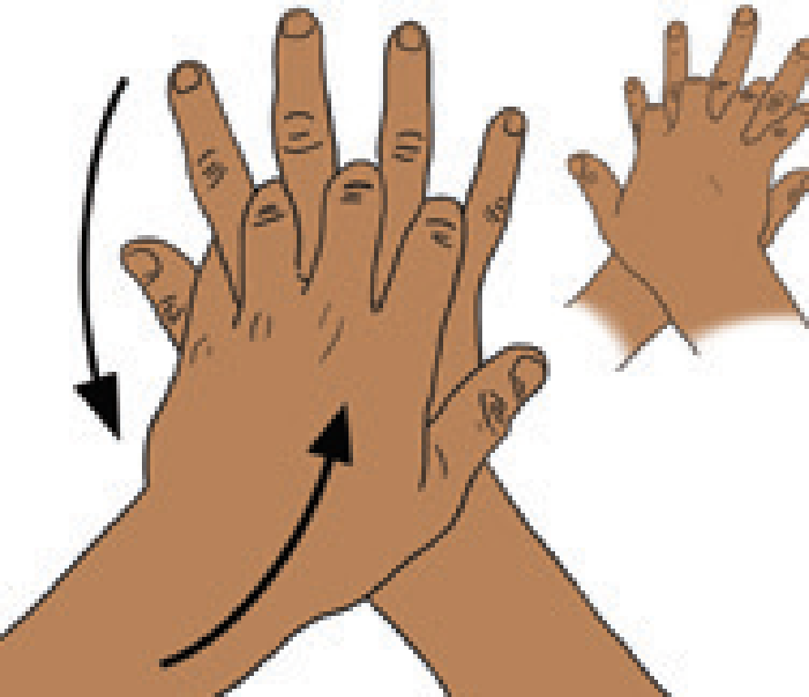
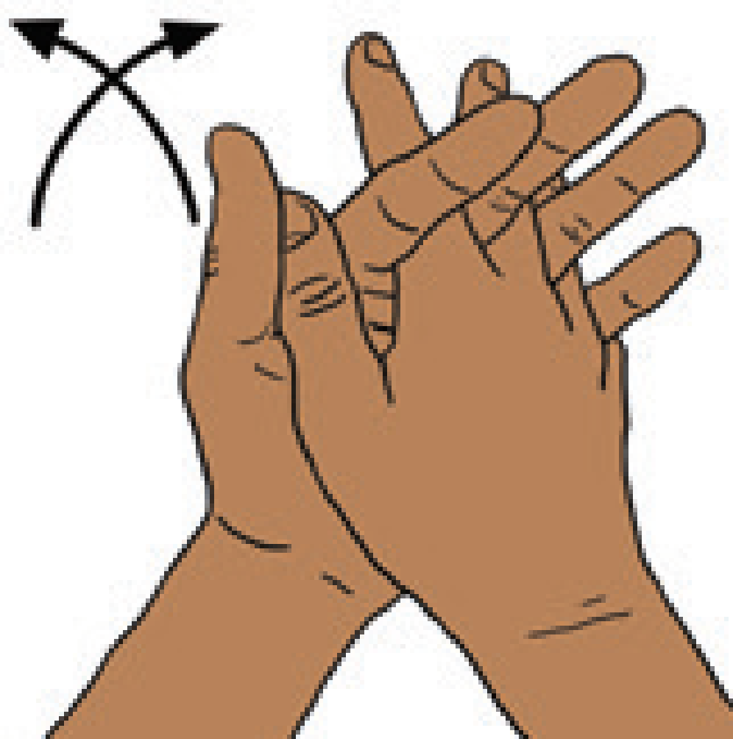
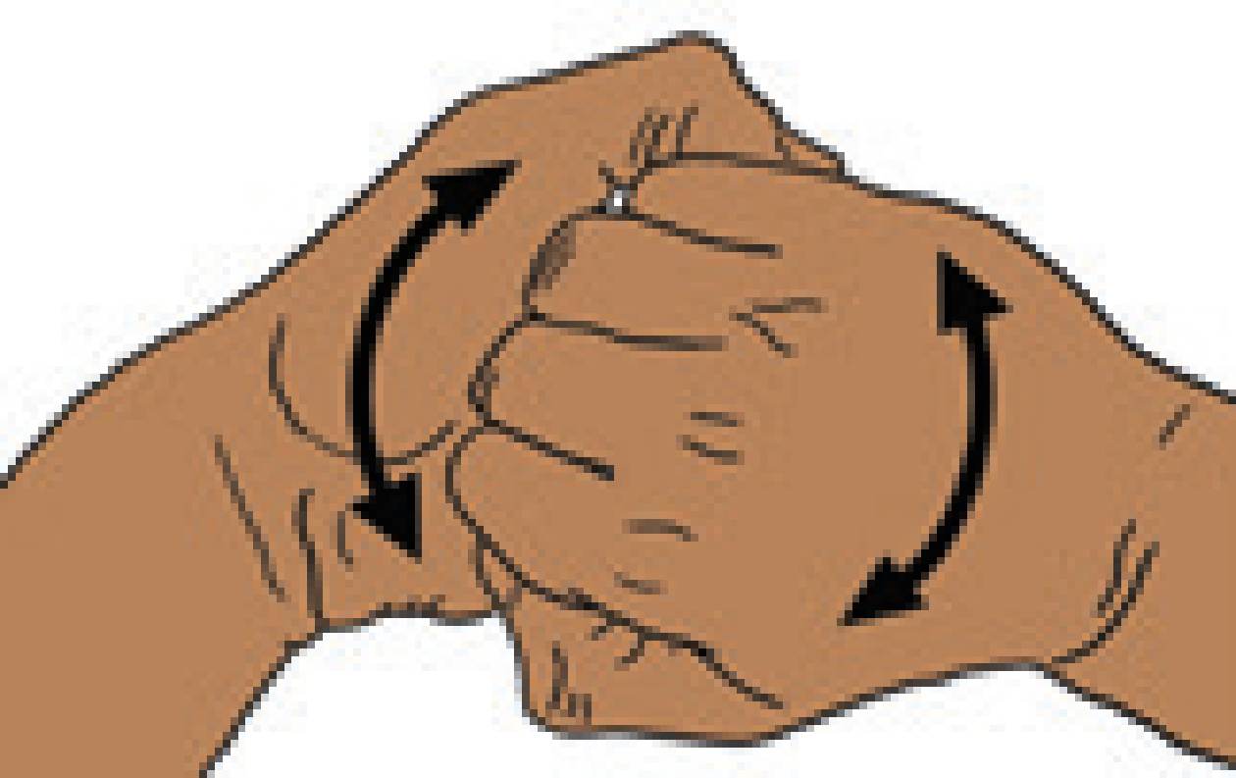
Step 1: Hand Hygiene
Perform hand hygiene before preparing injections
Perform hand hygiene before a clean procedure (injection) and after exposure to blood/body fluid or patient contact (after injection)
Glove use does not replace the need for hand hygiene
Notes:
Script:
First, before preparing an injection, you should perform hand hygiene. You also need to perform hand hygiene before giving the injection and after the injection. While you may use gloves, glove use does not replace the need for hand hygiene.

Slide 7
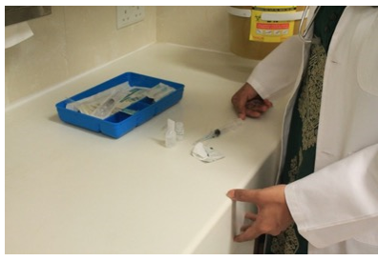
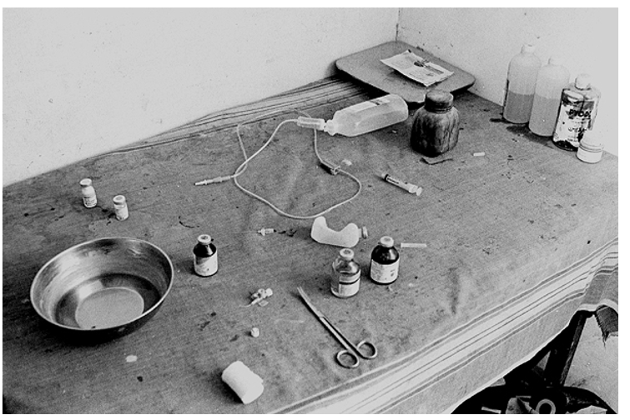
Step 2: Clean Workspace
Prepare injection in a clean, designated area
Notes:
Script:
Besides clean hands, you need a clean workspace. When preparing an injection, always do so in a clean, designated area.

Slide 8
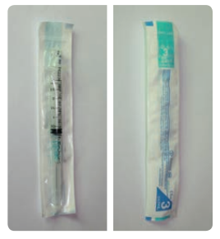
Step 3: Sterile Needle and Syringe
Always use a sterile syringe and sterile needle.
1 needle and 1 syringe for 1 patient 1 time
DO NOT use a needle or syringe if the packaging has been punctured, torn, or exposed to moisture
New and undamaged packaging
Notes:
Script:
Always use a sterile syringe and a sterile needle. You should use a needle and syringe only one time for one patient. If possible, use a needle and syringe with re-use prevention and/or an injury protection feature
If the needle or syringe packaging has been punctured, torn, or exposed to moisture it may be contaminated, and you should not use it.
Depending on the health facility and supply chains, we see a lot of needle and syringe re-use, and there’s some anecdotal evidence from past outbreaks that re-using needles and syringes might be contributing to amplification of Marburg virus disease in healthcare facilities especially in areas where injections are seen as a therapeutic standard as opposed to oral medication. Using sterile needles and syringes is important.

Slide 9
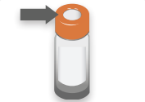
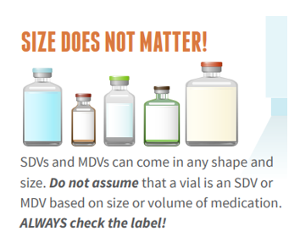
Step 4: Sterile medication vial
Medication Vials
Always read vial labels and follow product-specific recommendations for use, storage, and handling.
Check the route of administration (intramuscular? intradermal?) and the expiration.
Wipe the stopper/diaphragm with 70% alcohol (or other available antiseptic) and allow to air dry
Only enter a medication vial with a sterile needle
Single-dose and Multi-dose Medication Vials
Use single-dose medication vials whenever possible
If using a multi-dose vial, disinfect diaphragm before each use and use sterile needle and syringe each time to avoid contamination
Notes:
Script:
You may be noticing a pattern here: clean hands, clean workspace, sterile needle and syringe, and now we add a sterile medication vial.
You should always read medication vial labels and follow the product-specific recommendations for use, storage, and handling. You should also check the route of administration. Is it intramuscular? Is it intradermal? And you should check the expiration date on the vial or ampoule. If the expiration date has passed, you should not use the medication.
To avoid contamination, before an injection, always wipe the stopper or diaphragm of a medication vial with 70% alcohol or other available antiseptic and allow it to air dry. Then, only enter the medication vial with a sterile needle. Single-dose medication vials are preferred whenever possible, but if you must use multi-dose vials, disinfect the diaphragm before each use and use a sterile needle and syringe each time to avoid contamination. Remember that the size or shape of a vial does not indicate whether it is a single-dose or multi-dose vial. Always check the label and do not use single-dose vials more than once.

Slide 10
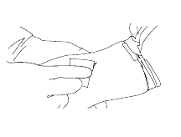
Step 5: Skin preparation
Apply a 60-70% alcohol-based solution (isopropyl alcohol or ethanol or other available antiseptic) to a cotton swab or single-use pad
Wipe the area from the center of the injection site outwards, but do not go back through the same area.
Apply the solution for 30 seconds and then let it dry completely.
DO NOT use cotton wools stored in a wet multi-purpose container
Notes:
Script:
The last step to ensure safety before giving an injection is to prepare the patient’s skin at the injection site.
To do this, apply a 60-70% alcohol-based solution ( such as isopropyl alcohol, ethanol or other available antiseptic) to a cotton swab or single-use pad.
Wipe the area where you will be giving the injection from the center of the injection site outwards, but do not go back through the same area.
Apply the solution for 30 seconds and then let it dry completely.
When doing this, DO NOT use cotton wools stored in a wet multi-purpose container
Now, with clean hands, a clean workspace, a sterile needle and syringe, a sterile medication vial, and a prepared injection site, you are ready to give the injection safely.

Slide 11
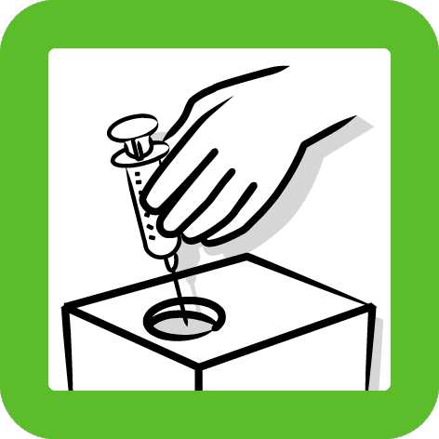
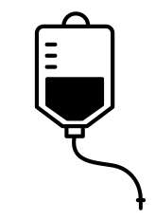
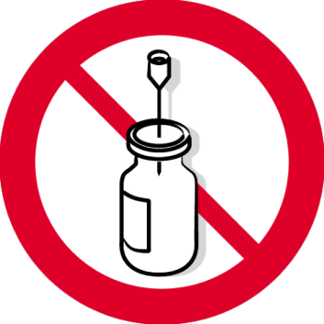
Step 6: Appropriate Collection of Sharps
DO
Discard needle and syringe immediately after use
DO NOT
Detach the needle from the syringe
Recap needles
Bend or break the needle
Leave a needle in a vial or IV bag
Overfill sharps containers
Notes:
Script:
But safe injection practices don’t end with the injection. How you dispose of needles and syringes is also important. Ideally, when giving an injection, a sharps box is within arm’s reach. Immediately after giving an injection, you should discard the needle and syringe in the sharps box.
You should never detach the needle from the syringe. Both pieces should be placed in the sharps container as a whole to reduce the risk of a sharps injury. You should avoid recapping needles as seen in this image bottom left, bending or breaking needles, or leaving needles in a vial or in an IV bag as you can see pictured in the images in the center and bottom right here. You should also never overfill sharps containers. These poor practices for injections can lead to contamination or accidental needle sticks, which can lead to transmission of Marburg virus disease to you or your patients.

Slide 12
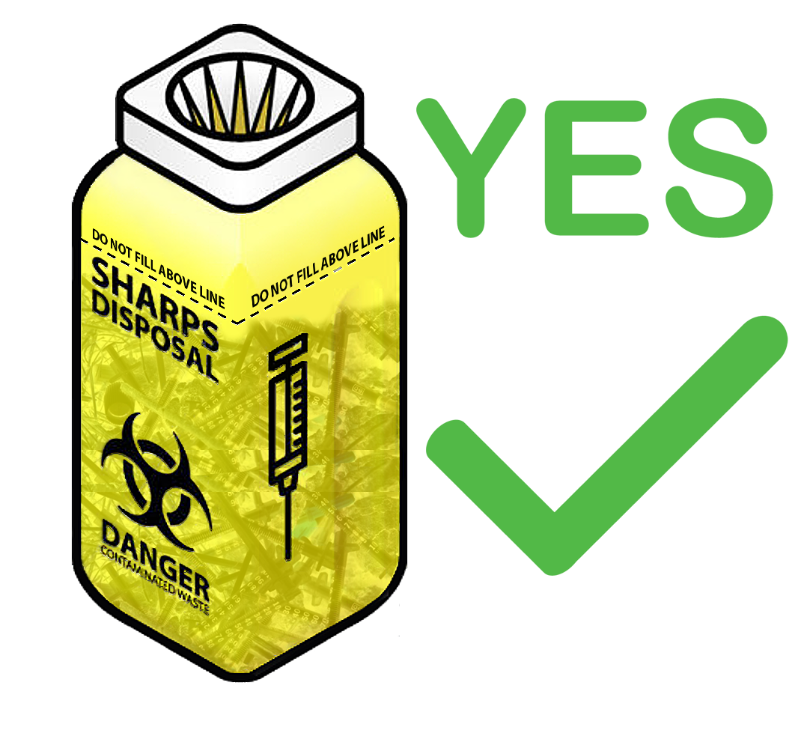
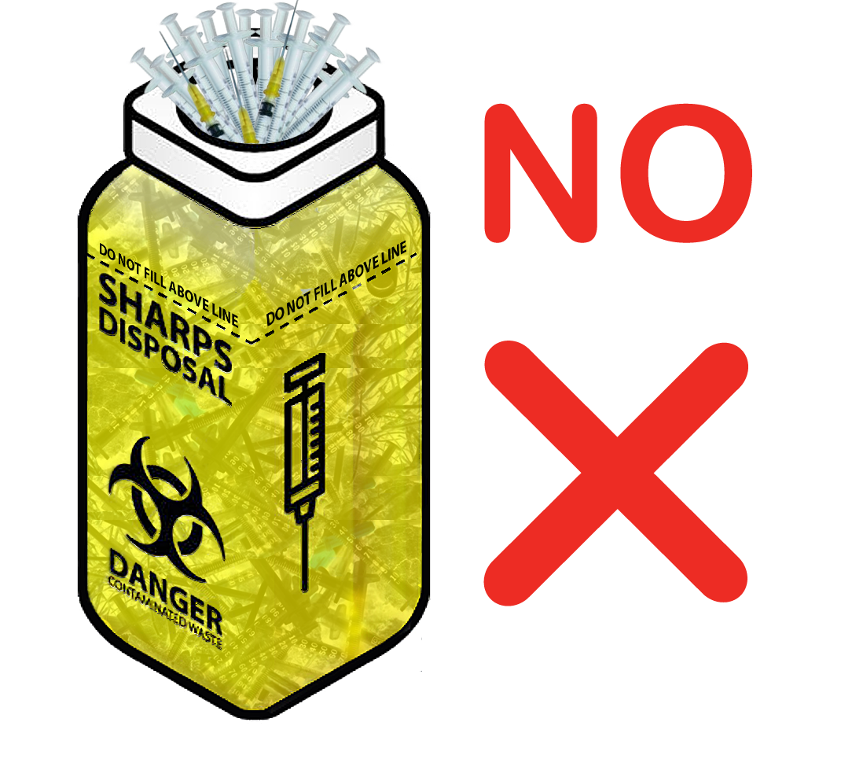
Step 7: Appropriate Waste Management
Sharps containers
Should NOT be overfilled
Location
In each patient care area
Within arm’s reach when giving an injection
On a medicine cart, on a wall, or on a nearby table/surface
NOT on floor (dangerous for children; cardboard boxes can break with repeated moisture/water on floor)
Notes:
Script:
Ideally, sharps containers will be located in each patient care area within arm’s reach of where you’re giving an injection. Importantly, sharps containers should not be placed on the floor where children could potentially reach them or where repeated exposure to moisture on the floor could cause certain types of containers to break down. Instead, sharps containers could be located on a medicine cart, on a wall, or on a nearby surface such as a table.
When disposing of needles and syringes, do not overfill sharps containers.

Slide 13
Knowledge Check: Sharps Safety
What needs to change to make sharps disposal safer here?

Slide 14
Feedback: Sharps Safety
Sharps box should be placed off the ground
Right now, it’s easy for children or others to reach in
Sharps waste needs to be in the sharps container – not just on top
Needles should not be recapped or detached from syringes
Separate bins for waste segregation is a good practice.
But gray box should be labeled

Slide 15
Reflection
What challenges do you encounter in your facility to the practice of 1 needle, 1 syringe for 1 patient, 1 time? How can these challenges be overcome?
What challenges do you encounter in your facility to disposing of needles and other sharps safely in sharps containers? How can these challenges be overcome?
Notes:
Reflection: Encourages participants to apply, analyze, and/or evaluate what they’ve learned, helps them to deepen their understanding of the topic and also helps you to check their comprehension of what they learned.
Personalization: Helps participants think about how what they have learned applies to their specific situations. Connecting learning to personal experiences helps learners to better understand and remember the ideas taught.
Script:
Now that we’ve discussed ideal injection safety practices, let’s discuss what this might look like at your facility(ies). What challenges have you encountered in your facility(ies) to the practice of 1 needle, 1 syringe for 1 patient 1 time?
[Give participants a couple of minutes to respond; you may want to write their answers on a blackboard or whiteboard or on a large sheet of paper if you have these materials.]
What are some ways these challenges can be overcome?
[Answers will vary. You may also offer suggestions as you see fit.]
What challenges do you encounter in your facility to disposing of needles and other sharps safely in sharps containers?
[Give participants a couple of minutes to respond; you may want to write their answers on a blackboard or whiteboard or on a large sheet of paper if you have these materials.]
How can these challenges be overcome?
[Answers will vary. You may also offer suggestions as you see fit.]

Slide 16
Key Takeaways
Protect patients → 1 syringe and 1 needle for 1 patient 1 time.
Protect Yourself → Dispose of needles and other sharps correctly
Notes:
Script:
This concludes our session for today. Before you leave, I want to review some key points that I hope you’ll take away from our time together. Remember that injection safety helps protect you, your co-workers, and your patients.
Because Marburg virus disease can potentially be spread by re-using needles, it’s vital to use only one syringe and one needle for only one patient only one time.
To protect yourself from accidental needle sticks that could potentially infect you with the virus, it’s crucial to dispose of needles and other sharps correctly.

Slide 17
Thank you!

